Slide 1
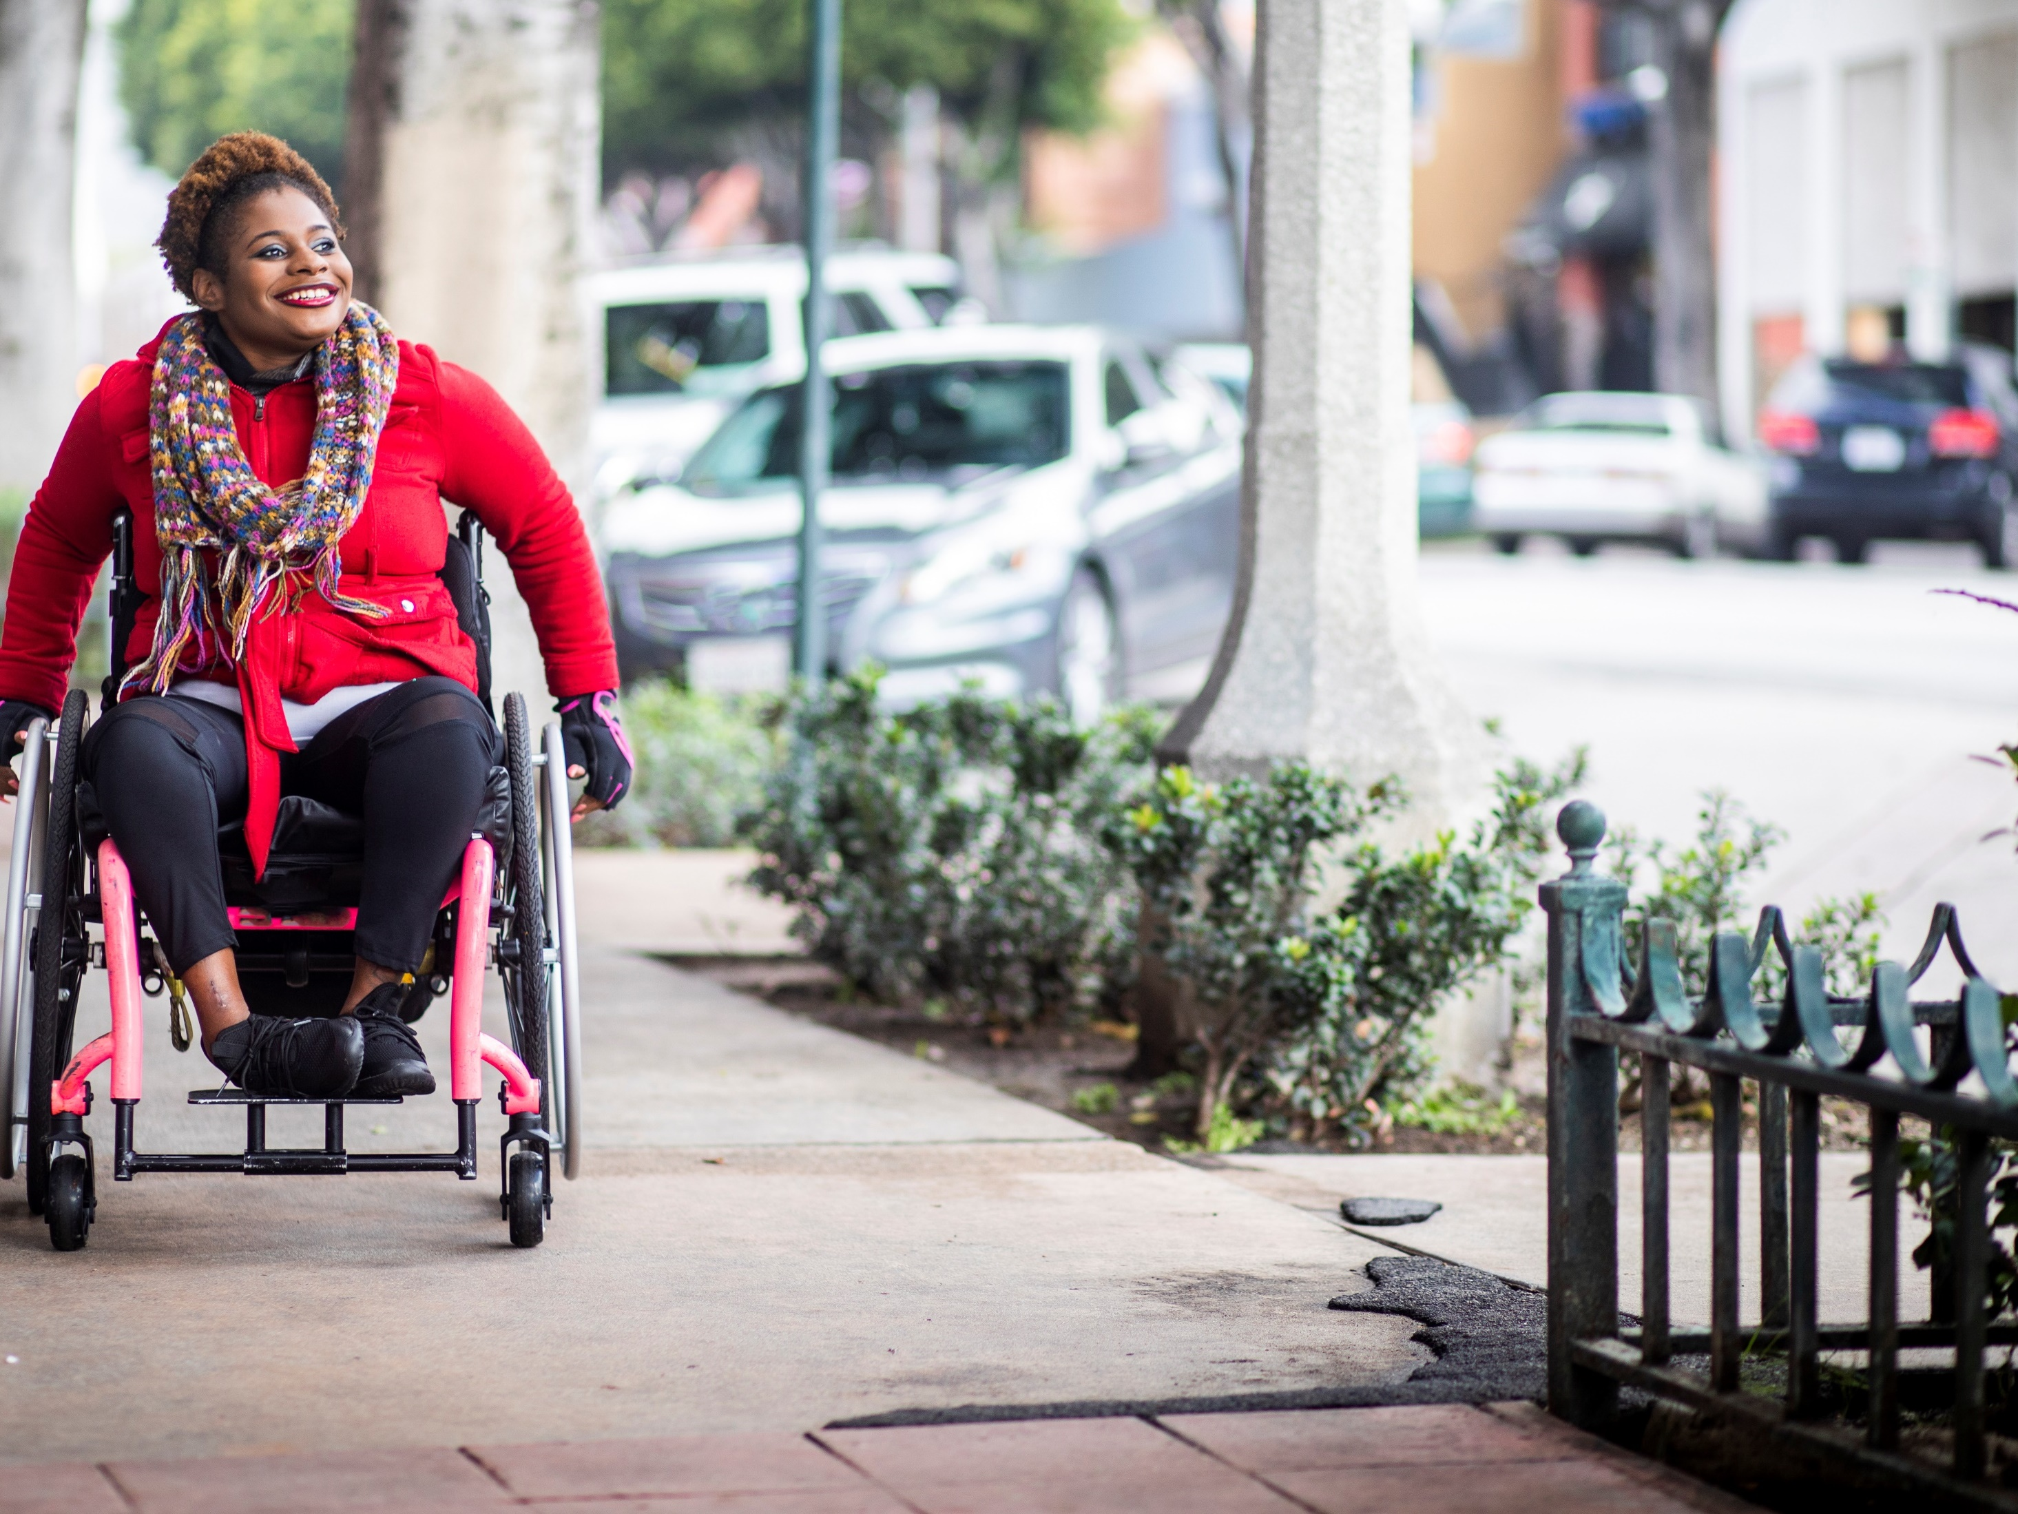


Can Physical Activity Improve the Health of Wheelchair Users?
NIH Pathways to Prevention Workshop:
December 1–3, 2020
Register today!
prevention.nih.gov/P2P-PAforWheelchairUsers
Notes:
This workshop will assess the scientific evidence to better understand the potential benefits of physical activity interventions for people at risk of using, or currently using, wheeled mobility devices such as a manual wheelchair, motorized wheelchair, or scooter.
The workshop is free and open to the public, and is designed for researchers, health care professionals, and non-scientists. Individuals who use wheeled mobility devices and caregivers are particularly encouraged to attend.
Workshop Sponsors:
National Center for Medical Rehabilitation Research,
Eunice Kennedy Shriver National Institute of Child Health and Human Development
National Institute of Neurological Disorders and Stroke
NIH Office of Disease Prevention

